Slide 1
PowerShell + Office365 = Deliver Excellence
Chendrayan venkatesan
Shell | cloud Infrastructure Automation engineer
@Chendrayanv

Slide 2

About Me….
Chendrayan Venkatesan
MVP | MCTS | MCP | ITIL V3
@ChendrayanV
Blogger | Speaker | Author |
Loves to do funky stuffs……

Slide 3
Agenda
Web framework for PowerShell
The What? Where? Why and How?
Polaris and PSHTML for Office 365 IT Pro.
My Story.
Get-Started.
Demo
Building Web Apps using PowerShell (Polaris + PSHTML).
Building RESTful API using PowerShell (Polaris + Other Datasource).

Slide 4
Web framework for PowerShell
There are many web frameworks used or experimented in PowerShell which are listed below
Pipeworks
Flancy
Nancy
PshOData
Presly
WebListener
PS-WebApi
PowerShellWebServers
Polaris which is a cross platform minimalist web framework for PowerShell
Polaris is built using PowerShell classes. That, helps IT Pro to use it easily and also to contribute.

Slide 5
The What? Where? Why? and How?
The What?
What’s it to business? Think of any GUI tool you are using can be replaced easily.
Render data in browser using PowerShell
Where?
Since Polaris is an experiment project – This is not for any production release.
Having said that, this can be used by power users (Office 365)
Why?
Cross Platform.
Building RESTful for any data source is easier.
How? – Let’s Park this for DEMO

Slide 6
PSHTML – An Introduction
PSHTML is a PowerShell module engineered by @StephanevG
It’s a community project available over GitHub and in PowerShell Gallery.
PSHTML allows us to create a HTML page using PowerShell like syntax.
In my opinion – It’s a best fit template engine for Polaris (Say PUG for Node.js)
I mean it! Yes, its PowerShell like syntax. So, logics are allowed.
……….PTO…………..

Slide 7
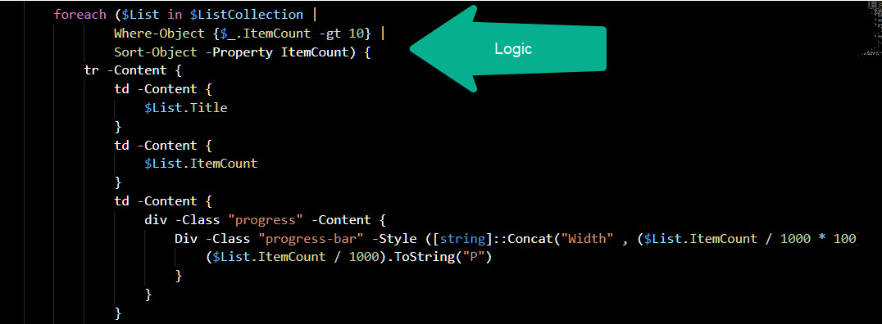
PSHTML - Demo

Slide 8
My Story
Used MVC portal for infrastructure automation and faced a major drift in sprint.
Considered Node.js and PowerShell which worked as expected and allowed us to deliver use cases at ease.
In future, I use Polaris as a my web server and PSHML as template engine to build apps.
15 + RESTful API has been shared with many clients (Few are Below)
MYSQL
SharePoint / Exchange
System Information

Slide 9
Get-Started
Both Polaris and PSHTML are available in PowerShell Gallery!
Install-Module PSHTML -Scope CurrentUser -Verbose
Install-Module Polaris -Scope CurrentUser -Verbose
Import-Module PSHTML -Verbose
Import-Module Polaris -Verbose
We are good to go!
If you need more fancy – Of course you need it! So, with no wait get bootstrap 4.1.3

Slide 10
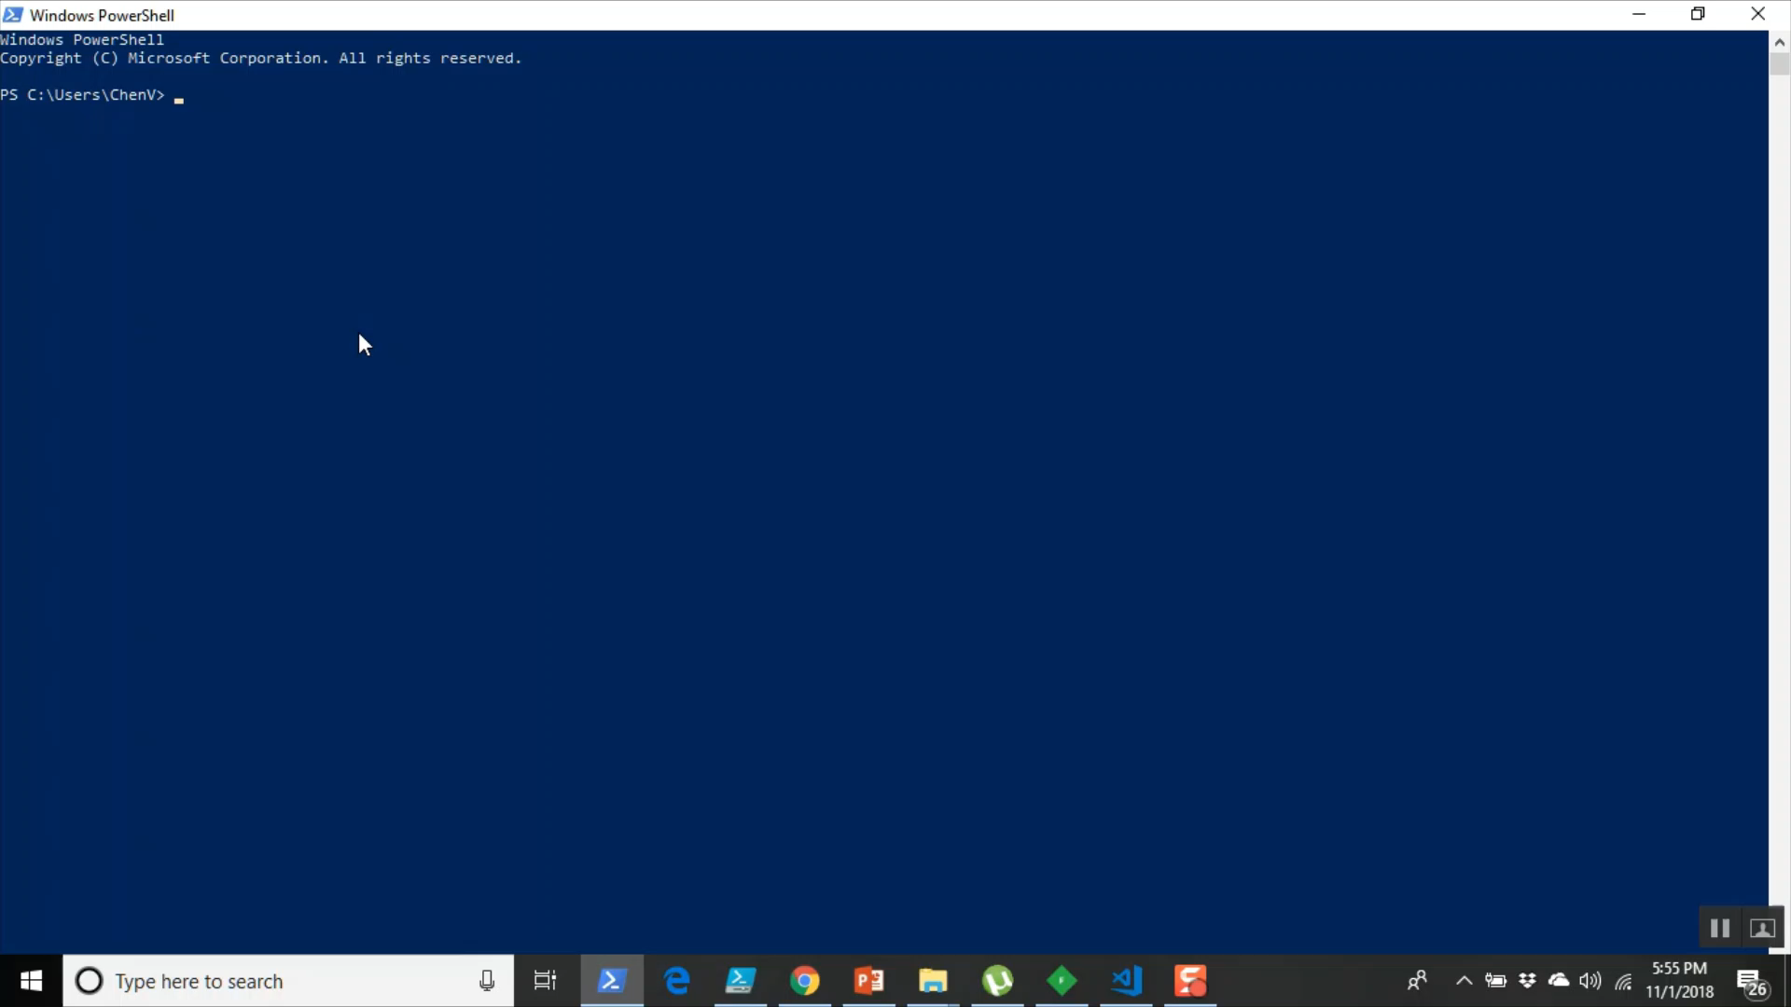
Demo

